Slide 1



Recruitment Portal
Recruiter's Hub

Slide 2

Student Details :
S.No.
Name
UID
1
Rahul
20BCS9498
2
Sheetal Singh
20BCS9525
3
Bhavya Thathera
20BCS9528
4
Shreyansh Shrivastava
20BCS9527

Slide 3

INTRODUCTION
In this project, we have basically designed a website in which Recruiters and the Job seekers can interact with each other. Now you must be thinking that this is a common website but we have also emphasized on the recruiter’s aspect. This website is focusing on the recruiter first. Yah! This is a new concept in this profession. Firstly, a job seeker can upload his data on this website and then a recruiter can visit our website and can see those persons list who want job in any particular field.

Slide 4


SOFTWARE
HTML:
HTML stands for Hyper Text Markup Language. Itis the standard markup language for creating Web pages. It describes the structure of a Web page. It consists of a series of elements. HTML elements tell the browser how to display the content.HTML elements label pieces of content such as "this is a heading", "this is a paragraph", "this is a link", etc.
Hypertext Markup Language (HTML) is the standard markup language for documents designed to be displayed in a web browser. It can be assisted by technologies such as Cascading Style Sheets (CSS) and scripting languages such as JavaScript.

Slide 5

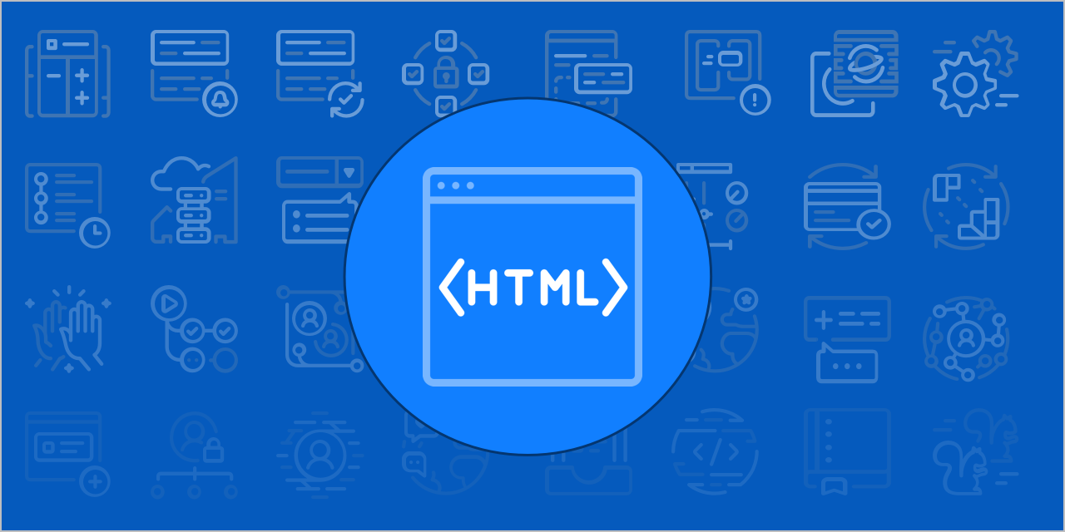

Slide 6


CASCADING STYLE SHEET-
CSS
CSS describes how HTML elements are to be displayed on the screen, paper, or in other media.
CSS saves a lot of work. It can control the layout of multiple web pages all at once.
External stylesheets are stored in CSS files

Slide 7
08
JAVASCRIPT
JavaScript often abbreviatedas JS, is a programming language that conformsto the ECMAScript specification. JavaScript is high-level, often just-in-time compiled, and multi-paradigm. It has curly-bracket syntax, dynamic typing, prototype-based object-orientation, and first-class functions. Alongside HTML and CSS, JavaScript is one of the core technologies of the World Wide Web. JavaScript enables interactive web pages and is an essential part of web applications.
The vast majority of websites use it for client-side page behavior, and allmajor web browsers have a dedicated JavaScript engine to execute it.

Slide 8

php
VOLUNTEER RESUME
16
PHP is a general-purpose scripting language that is especially suited to web development. It was originally created by Danish-Canadian programmer Rasmus Lerdorf in 1994; the PHP reference implementation is now produced by The PHP Group. PHP originally stood for Personal Home Page,[7] but it now stands for the recursive initialism PHP: Hypertext Preprocessor.
general-purpose scripting language that is especially suited to web development. It was originally created by Danish-Canadian programmer Rasmus Lerdorf in 1994; the PHP reference implementation is now produced by The PHP Group. PHP originally stood for Personal Home Page,[7] but it now stands for the recursive initialism PHP: Hypertext Preprocessor.

Slide 9

MySQL
SQL is a standard language for accessing and manipulating databases. SQL stands for Structured Query Language. SQL lets you access and manipulate databases. SQL became a standard of the American National Standards Institute (ANSI) in 1986, and of the International Organization for Standardization (ISO) in 1987
SQL can execute queries against a database, retrieve data, insert records in a database, update records, delete records, create new databases, create new tables in a database, create stored procedures in a database, create views in a database, set permissions on tables, procedures, and views

Slide 10
The recruiter remains up-to-date on the requirements of the various positions. Attracting suitable candidates through databases, online employment forums, social media, etc.
METHODOLOGY
Identifying future hiring needs and developing job descriptions and specifications. Users can search the latest job opportunities in the profession.
Assessing applicants' knowledge, skills, and experience to best suit open positions. Promoting the company's reputation and attractiveness as a good employment opportunity. Keeping up-to-date on current employment legislation and regulations and enforcing them within the company. Keeping up-to-date on current employment legislation and regulations and enforcing them within the company.

Slide 11

USER FEATURES:
A New Job Opportunity via Mail and information exchange
Wider audience reach due to website accessibility 24/7
Credibility.
Information Exchange

Slide 12



Admin Features :
Admin can control the data available on the database.
Admins can add content on all pages and access all items in the Admin Toolbar.
Admins can control site-wide settings like the design of your website and the homepage layout.
Admins can change the layout, format, outlook, images, links and functionalities of the website.

Slide 13
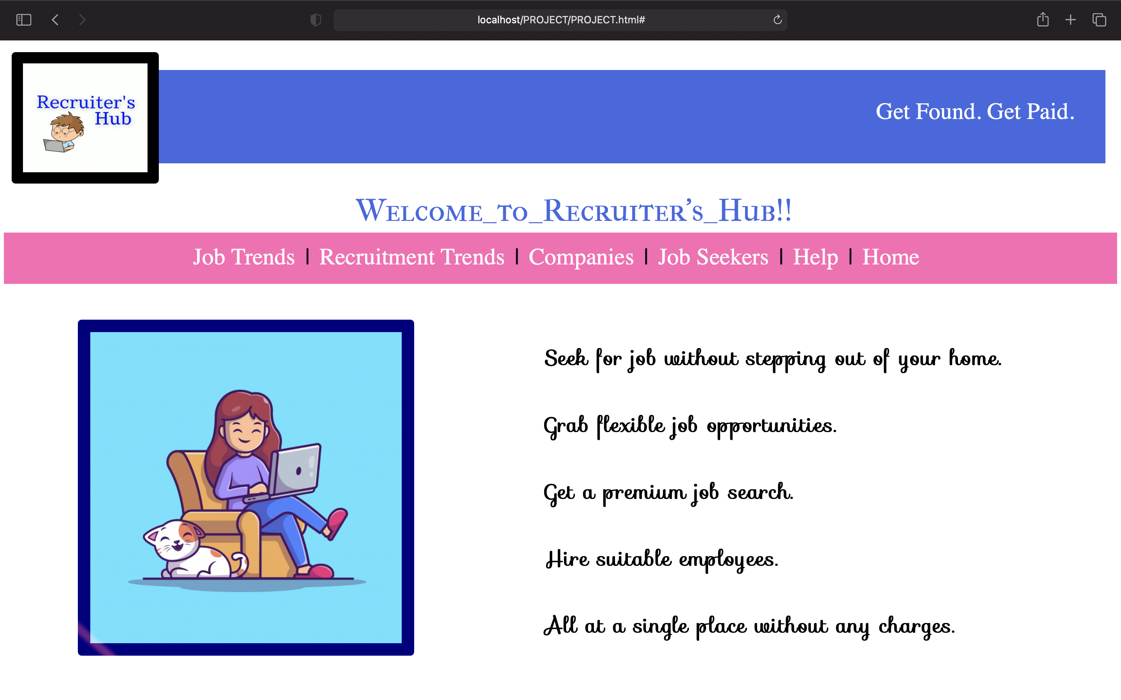
WEBSITE HOMEPAGE :

Slide 14
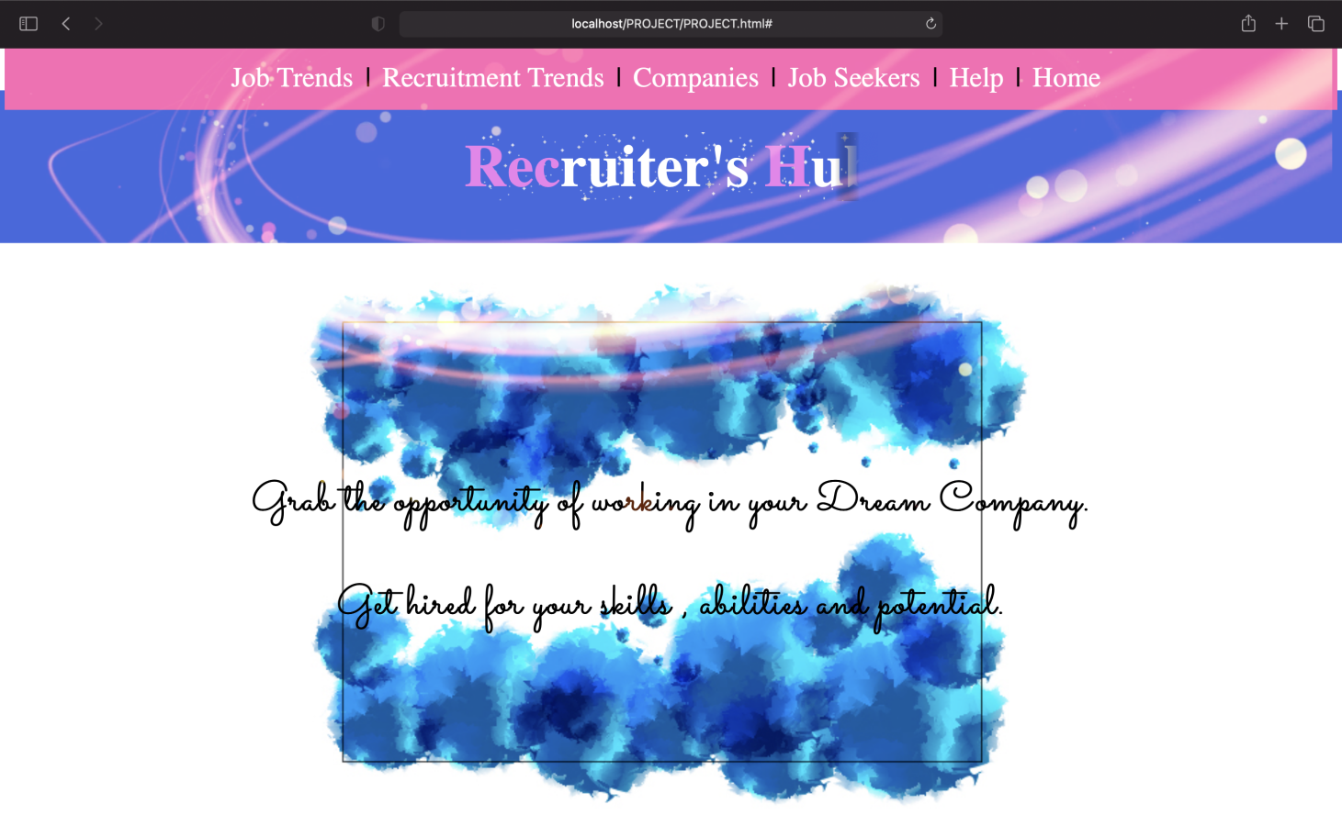

Slide 15
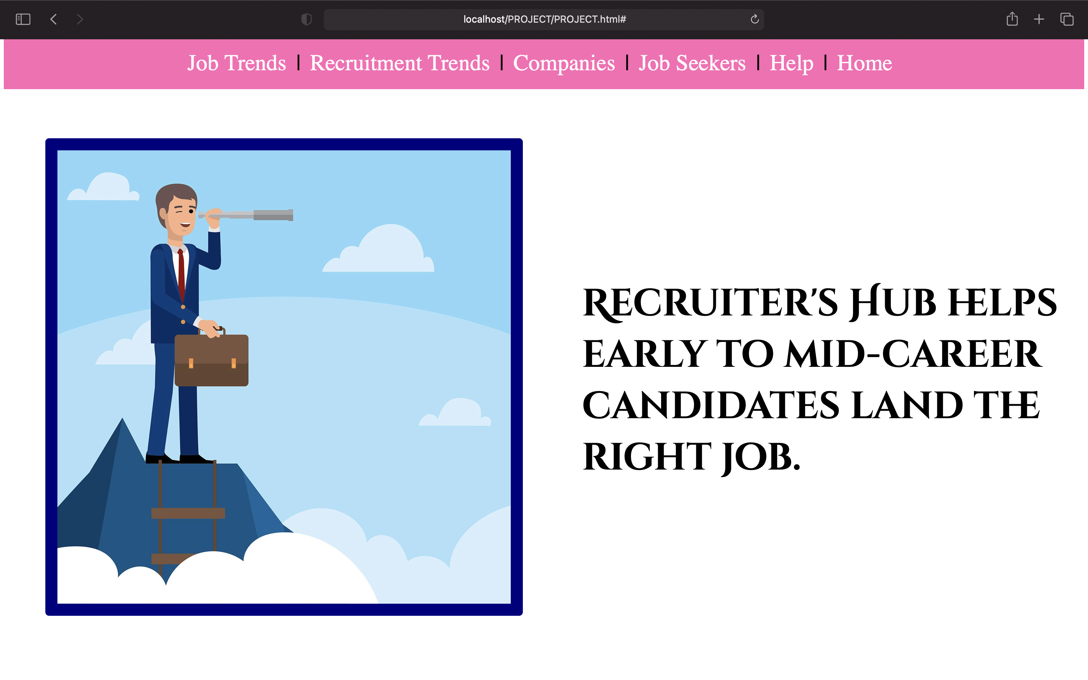

Slide 16
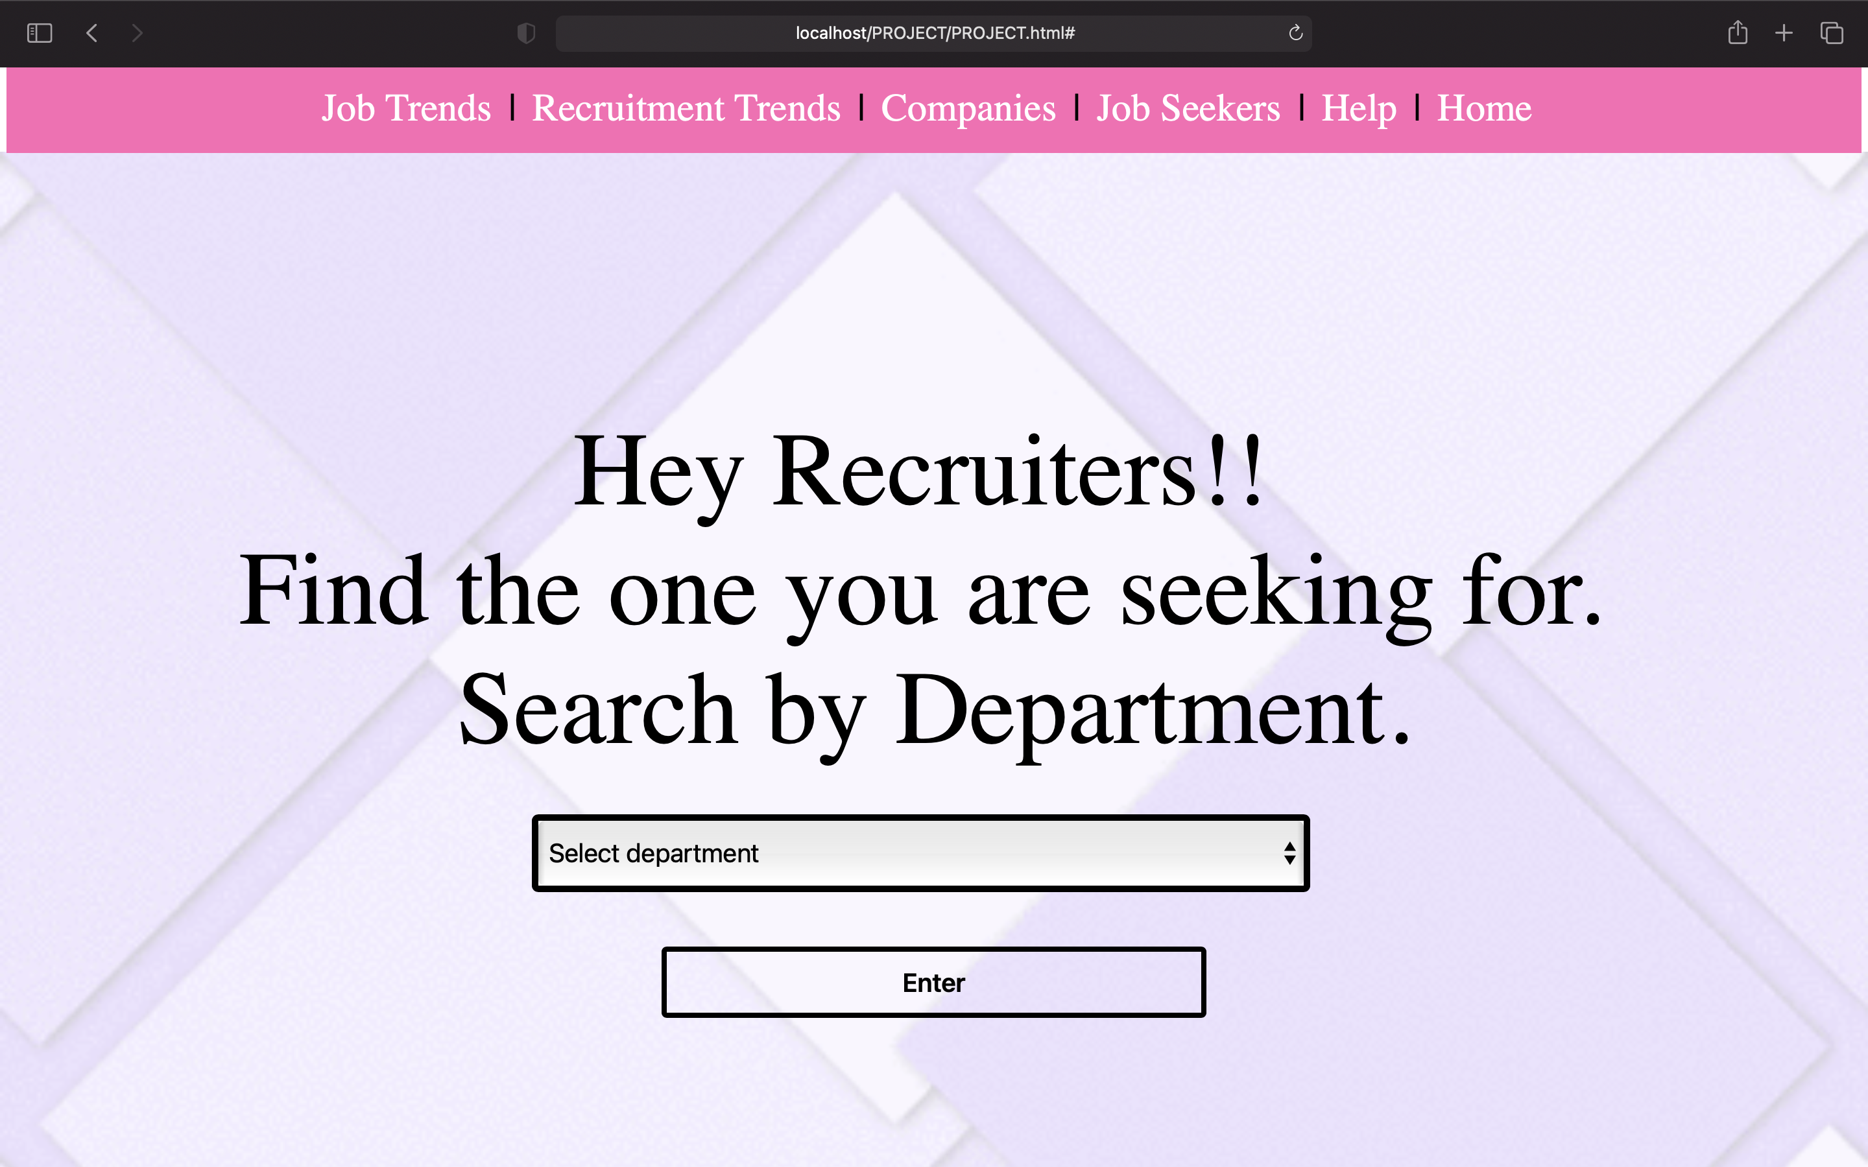

Slide 17
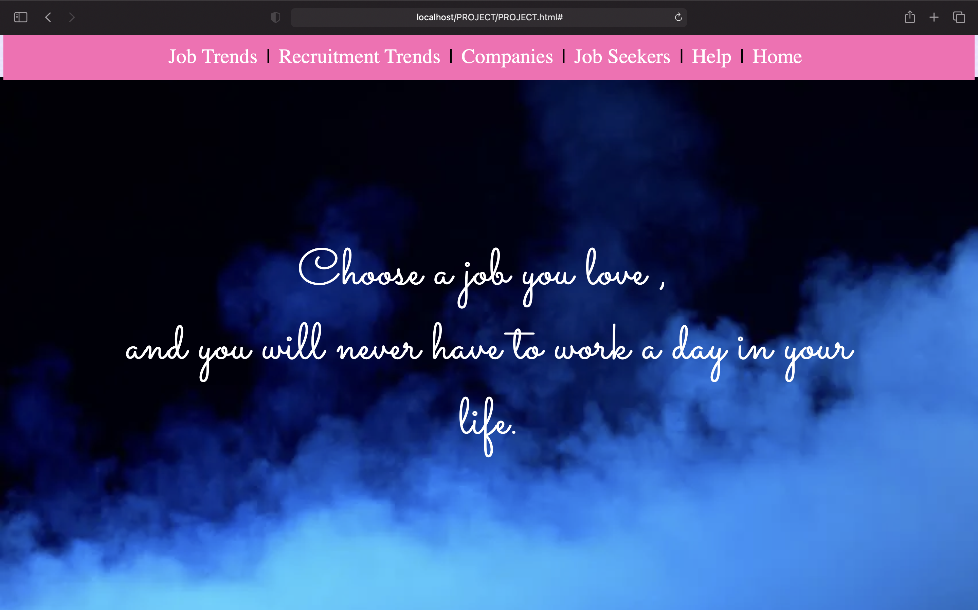

Slide 18
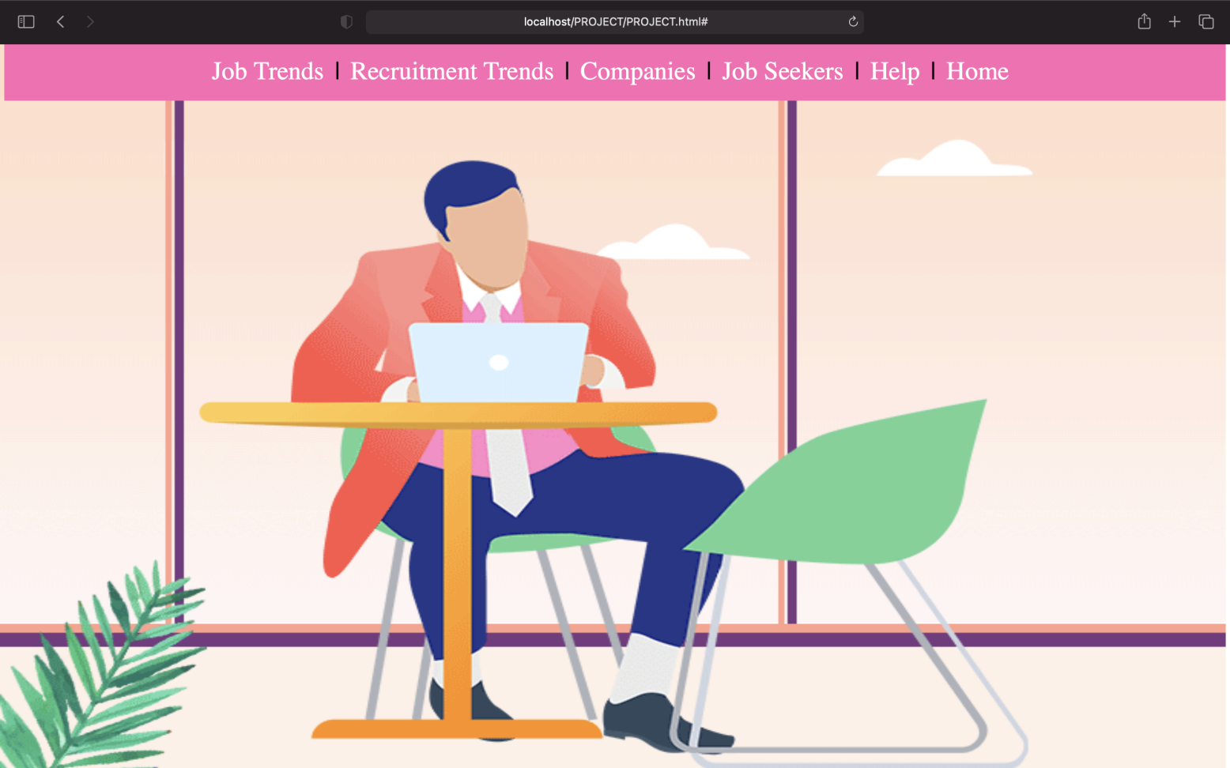

Slide 19
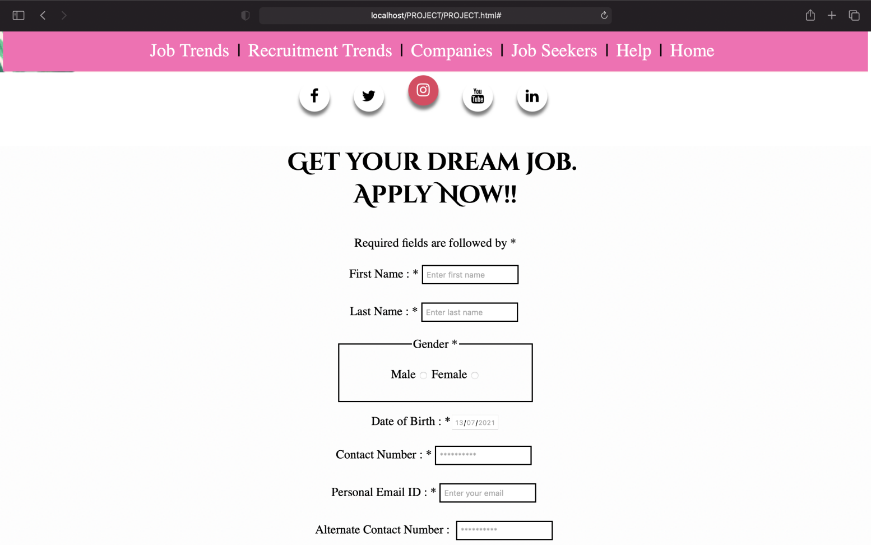

Slide 20
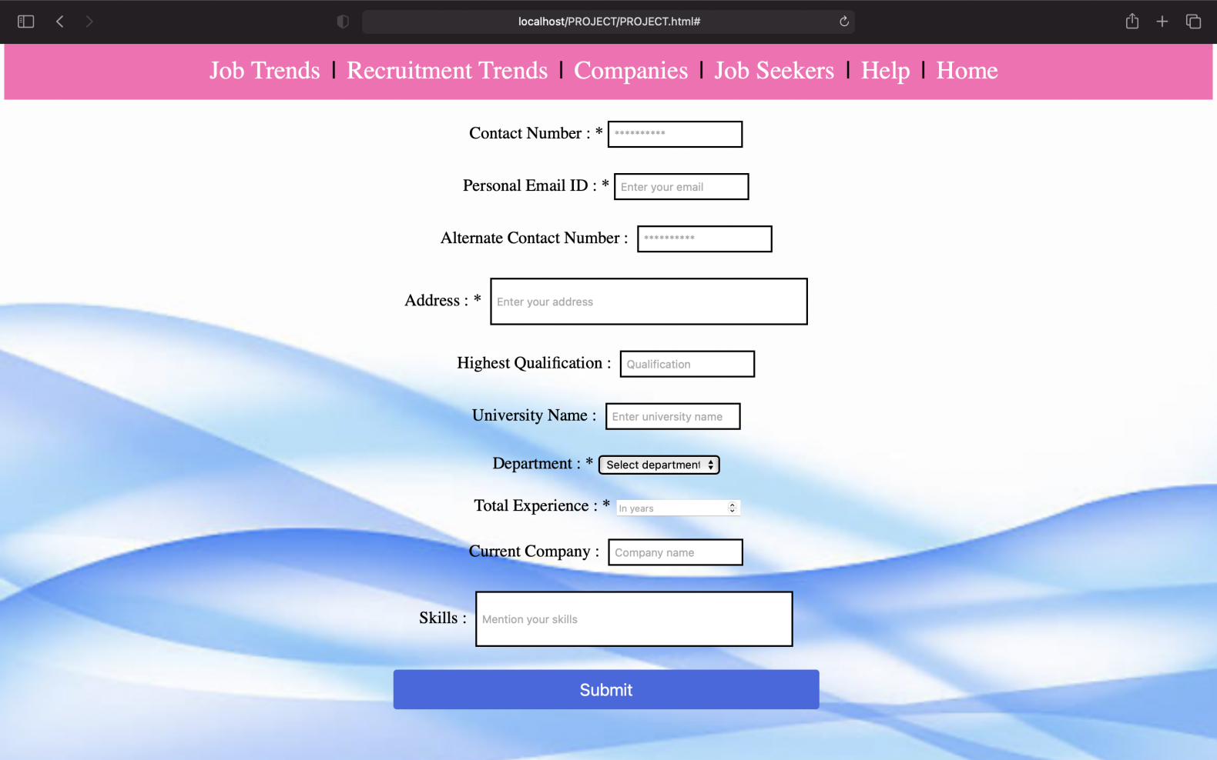

Slide 21
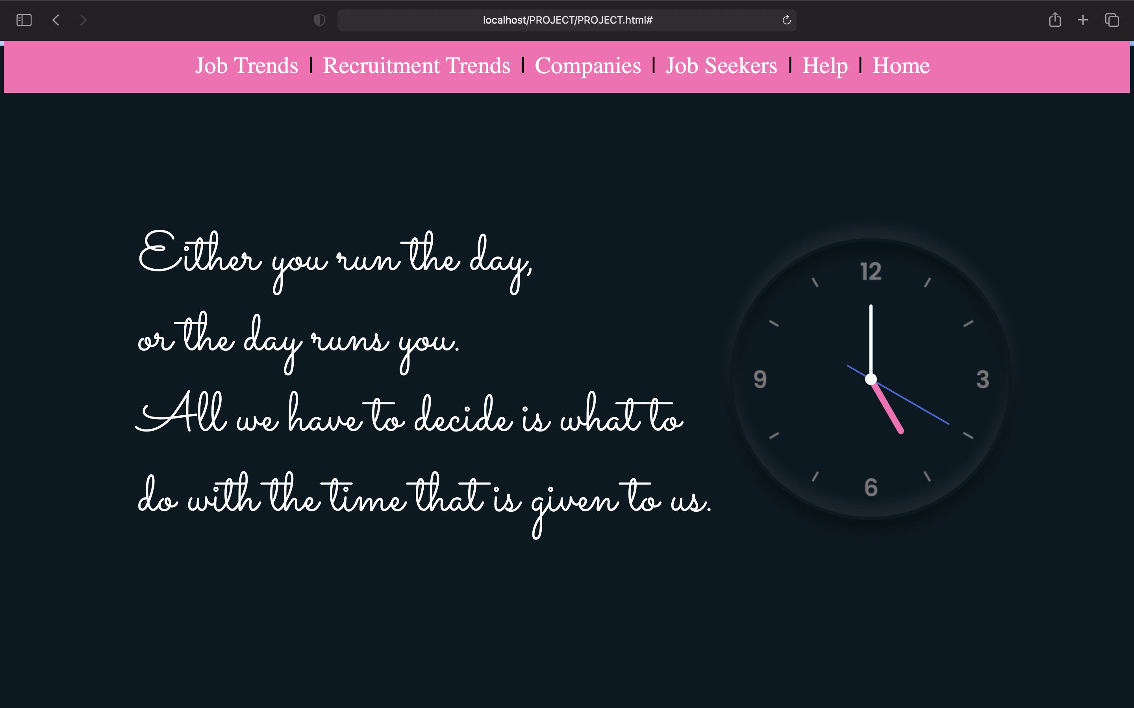

Slide 22
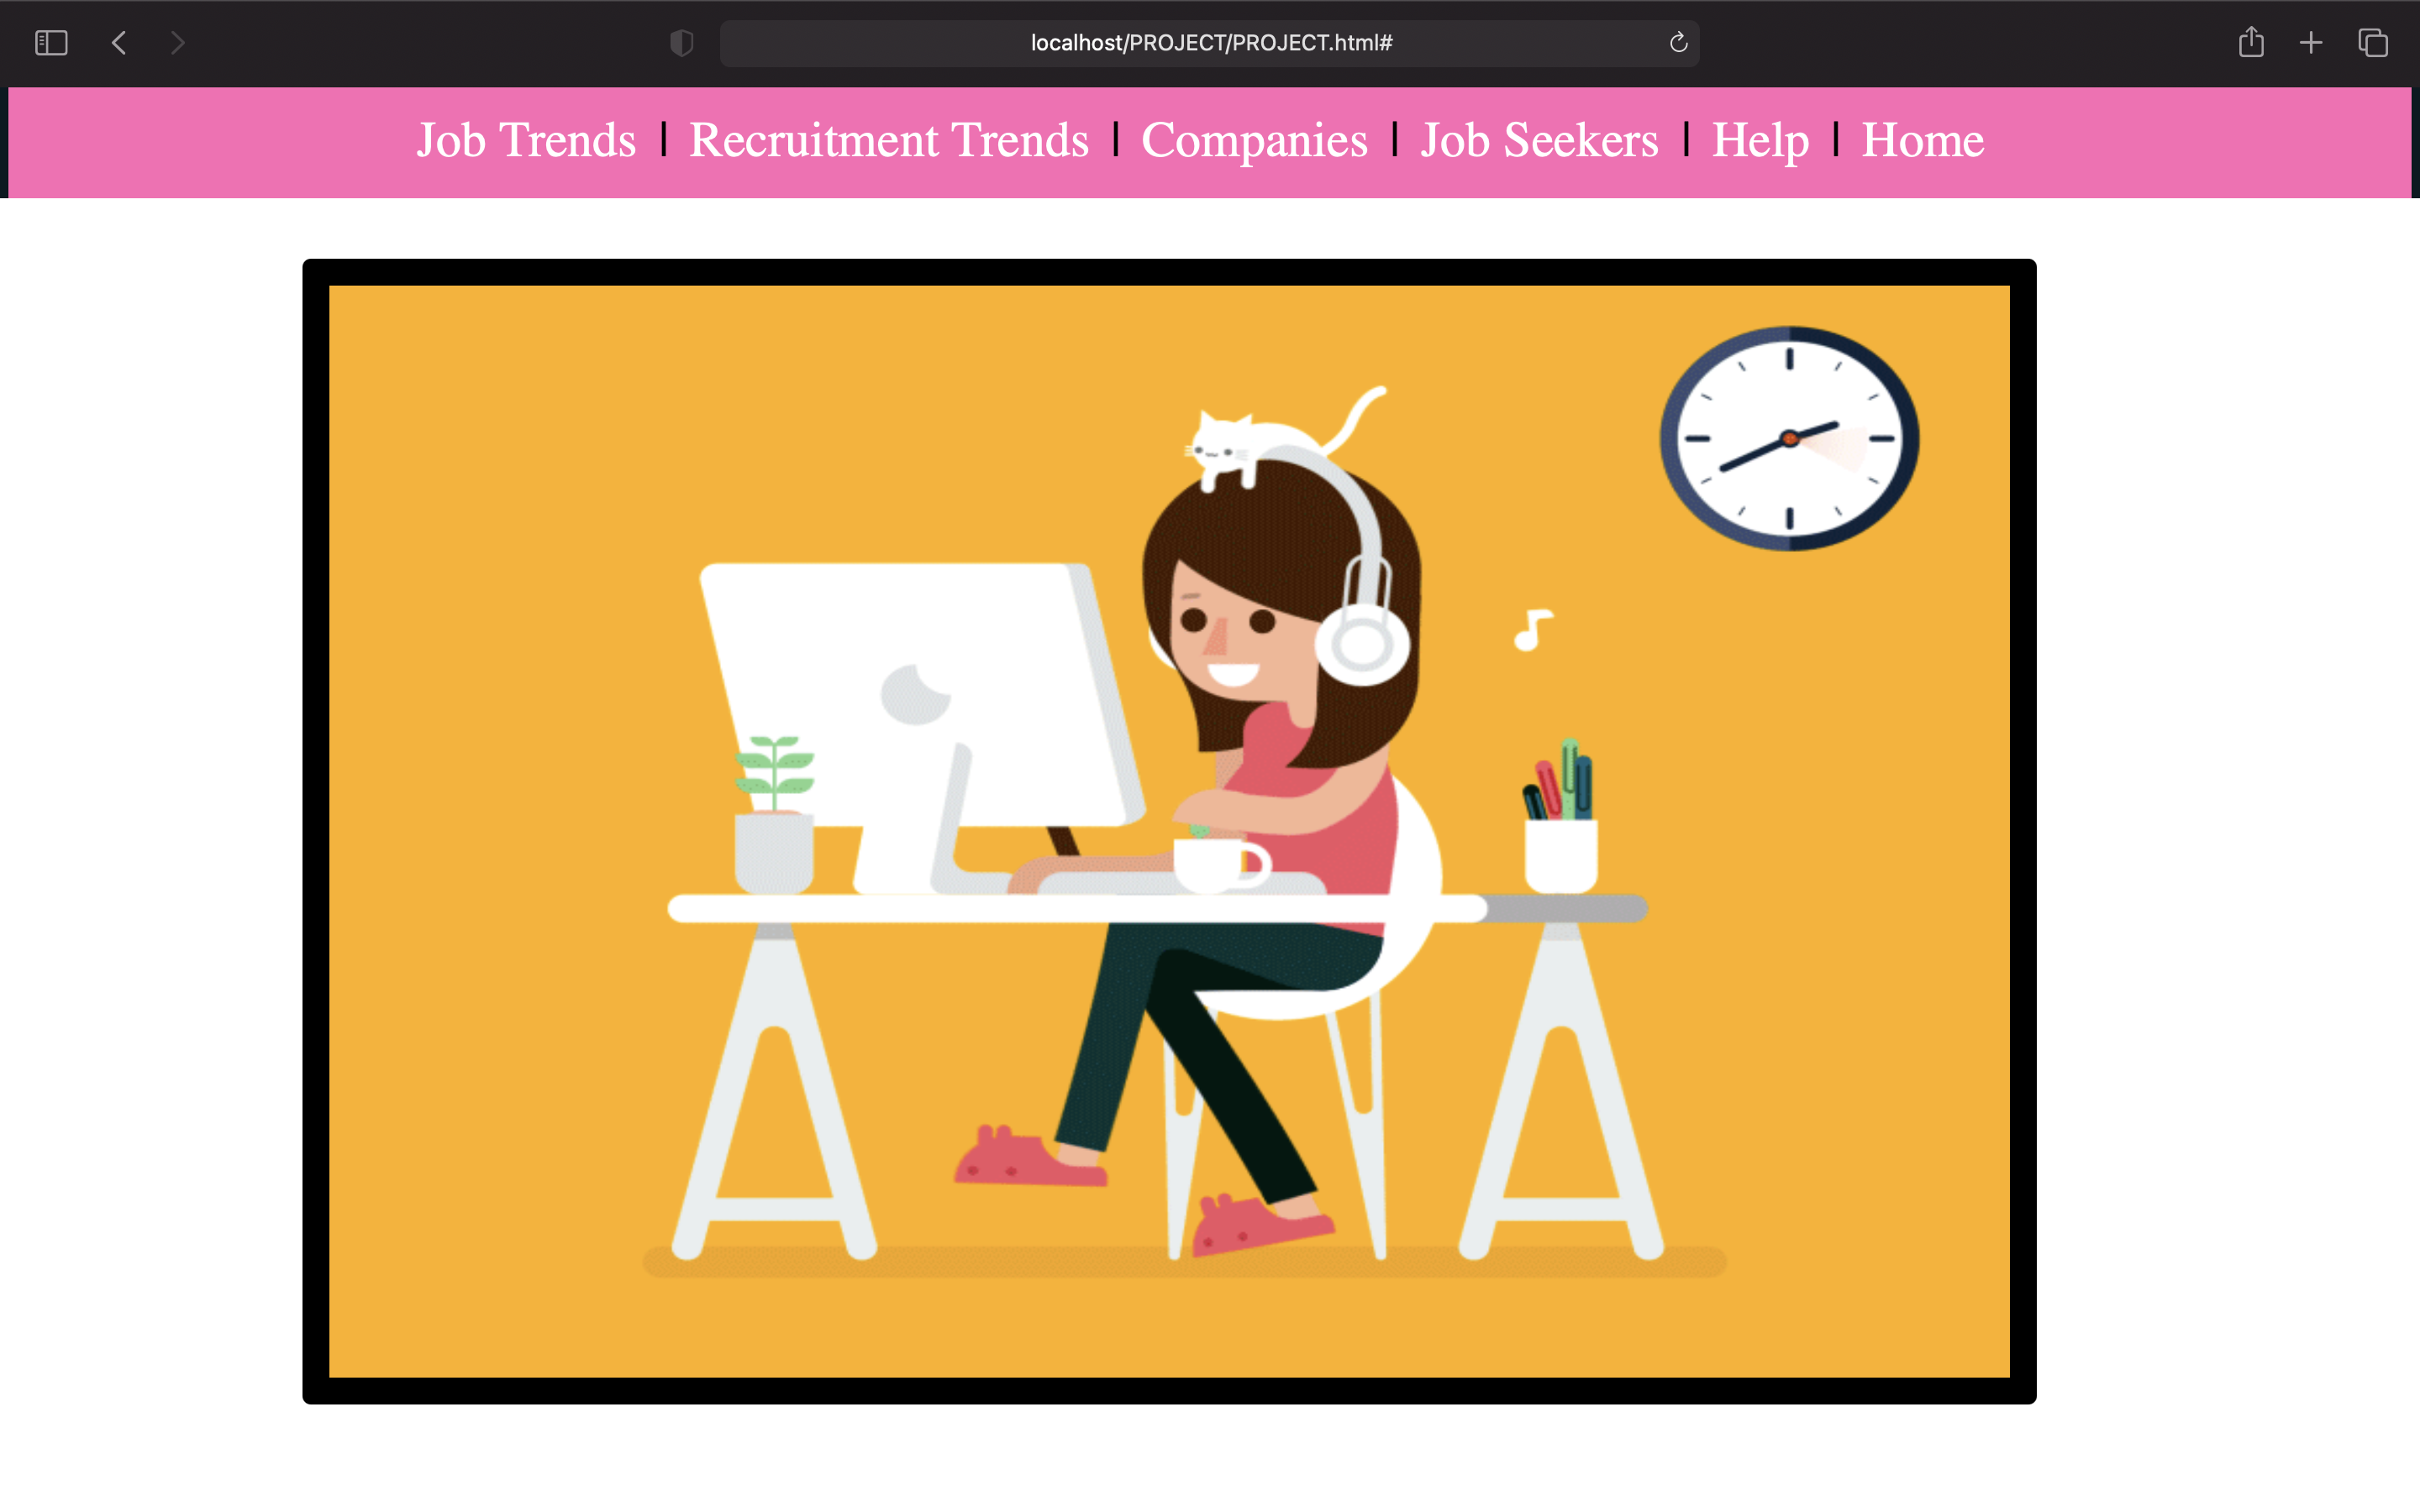

Slide 23
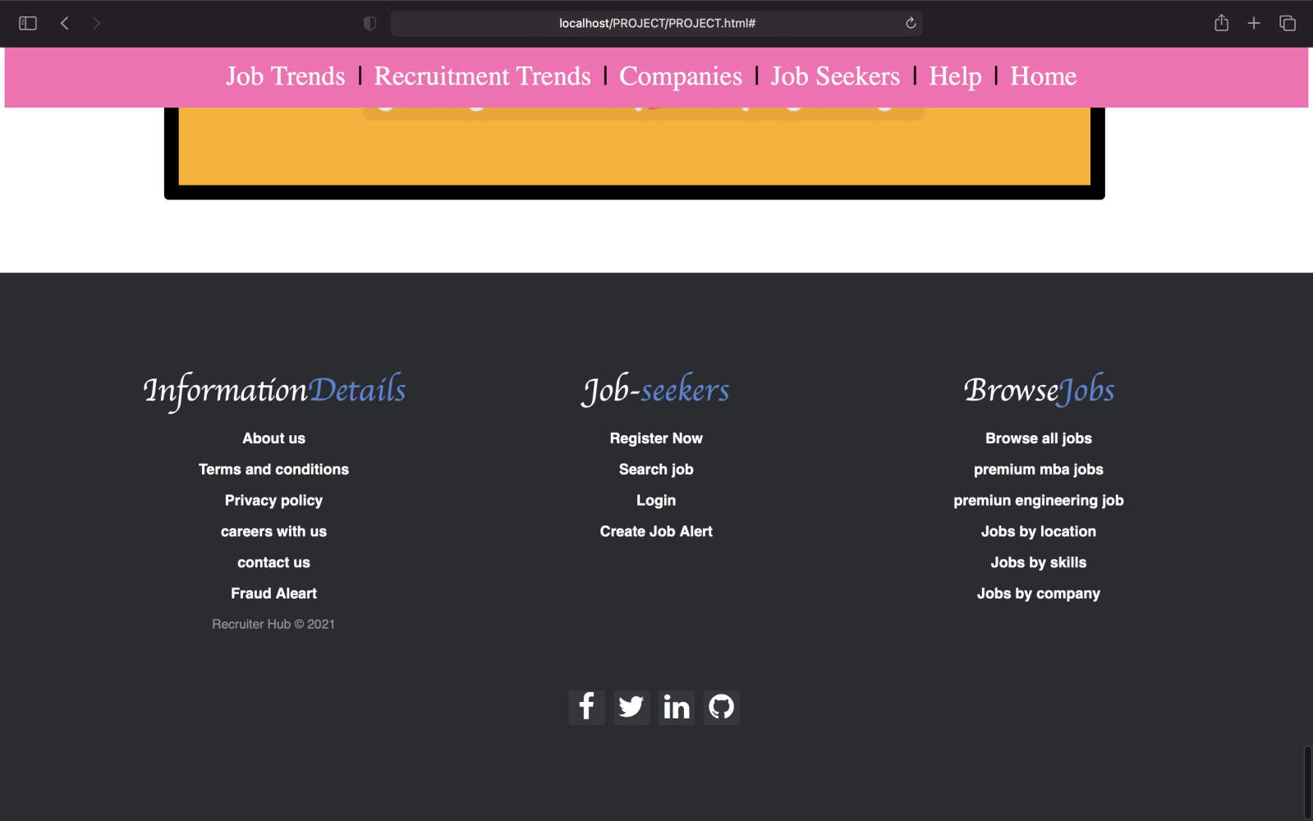

Slide 24



RESULT
The recruiter can help you create an ad that will attract the best-qualified candidates. Feel free to revise this outline to meet your specific job duties and job requirements, based on this structure and organization. You can get more ideas about how to write your posting by browsing our corporate job recruiter listings.
As a result, after implementing all the mentioned libraries as well as software tools, we finally full-fledged website where Job Seekers and Recruiters can perform their tasks easily and can communicate in a proper professional way with the help of our website.
As a result, after implementing all the mentioned libraries as well as software tools, we finally full-fledged website where Job Seekers and Recruiters can perform their tasks easily and can communicate in a proper professional way with the help of our website.

Slide 25



CONCLUSION
Our project is only a humble venture to satisfy the needs to manage their project work. Several user-friendly coding has also been adopted. The objective of the software planning is to provide a framework with a limited project completion time frame at the beginning of the project and should be updated on a regular basis.

Slide 26

FUTURE SCOPE:
AI: Enabling Productivity & Improving Recruiting Relationships.
Candidates Are Treating the Job Search on ease like an Online Shopping Experience.
A job site could provide job seekers with better matches without even having to search.
The future of the job portals looks bright. Job portals are like the meeting points for the recruiters as well as the job seekers.
Finding a job opportunity per your choice and qualification through a job portal is relatively easier.
In the short term, we will likely see a wave of new job portals.

Slide 27

THANK
YOU !!

